Slide 1

SDE Readiness Training
Empowering Tomorrow’s Innovators

Slide 2

Module I
Java Software Development: Effective Problem Solving

Slide 3

Control Flow Statements
Learning Level : Basics
Date : 04-05-2024

Slide 4
Contents
Introduction
Branching - Conditional
Looping
Nested Loop
Branching – Unconditional
Quiz

Slide 5
Introduction
Control Flow Statements
Control flow is the order in which individual statements or instructions of a program are executed or evaluated and Control flow statements is categorized as follows:
Control Statements
Sequential statement
Branching Statement
Looping Statement
for
Conditional Statements
Unconditional Statements
while
Simple If
do..while
break
If..else
If..elseif..else
continue
Switch case
Nested if

Slide 6
Introduction
Control Flow Statements
Sequential statements describe a sequence of actions that a program carries out one after another, unconditionally.
Execute a list of statements in order.
Example:
import java.util.Scanner;
public class CircleArea {
public static void main(String[] args) {
Scanner scanner = new Scanner(System.in);
System.out.print("Enter the radius of the circle: ");
double radius = scanner.nextDouble();
double area = Math.PI * radius * radius;
System.out.println("The area of the circle with radius " + radius + " is: " + area);
scanner.close();
}
}

Slide 7
Introduction
Control Flow Statements
Branching (Conditional) /Decision Making – To make decisions based on a given condition. If the condition evaluates to True, a set of statements is executed, otherwise another set of statements is executed. In Java, we have five types of decision making statements:
if
if…else
if-else-if
nested if
switch

Slide 8
Decision-Making : simple if
Control Flow Statements
Simple if: If the condition is true, the body of the if statement is executed. If it is false, the body of the if statement is skipped.
Syntax
if is a Java
reserved word
The condition must be a boolean expression.It must evaluate to either true or false.
if ( condition ){
statement(s);
}
If the condition is true, the statement(s) is/are executed.
If it is false, the statement(s) is/are skipped.

Slide 9
Decision-Making : simple if
Control Flow Statements
/** * The IfControlStructure class implements an application that * Illustrate the if decision Making control statement */ class IfControlStructure{ public static void main(String[] args){ boolean isMoving=true; int currentSpeed=10; if(isMoving){ System.out.println(currentSpeed); } } }
Output:
10

Slide 10
Decision-Making : simple if
Control Flow Statements
/** *The SimpleIf class implements an application that checks the seat availability status for movie ticket booking using *simple if decision Making control statement */ import java.util.Scanner; public class SimpleIf { public static void main(String[] args){ boolean seatAvailable = true; //Seat Available Status Scanner input = new Scanner(System.in); //Scanner class object creation System.out.println("Enter the Seat Number : "); String SeatNumber = input.next(); //get Seat Number from User

Slide 11
Decision-Making : simple if
Control Flow Statements
if(seatAvailable){ //Check the availability of seat System.out.println("Your have booked the seat number : "+SeatNumber); } input.close(); } }
Output:
Enter the Seat Number : A32
Your have booked the seat number : A32

Slide 12
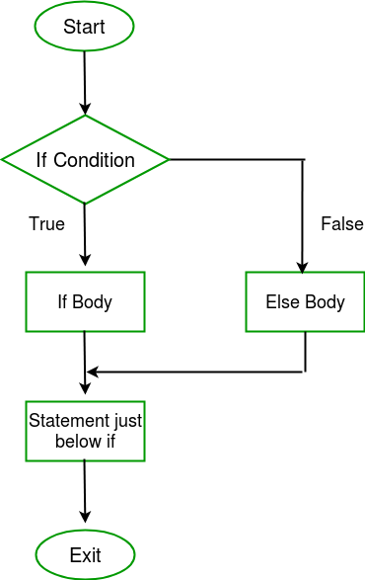
Decision-Making : simple if - else
Control Flow Statements
if –else: If the condition is true, the body of the if statement is executed. If it is false, the body of the false statement is executed.
Syntax
if ( condition ){
if Body;
}
else{
else Body;
}

Slide 13
Decision-Making : simple if - else
Control Flow Statements
/** * The IfEsleControlStructure class implements an application that Illustrate the if ..else decision Making control statement */ class IfElseControlStructure{ public static void main(String[] args){ boolean isMoving=true; int currentSpeed=10; if(isMoving){ currentSpeed--; System.out.println("The bicycle speed got reduced!"); } else{ System.out.println(“The bicycle has already stopped!”); } } }
Output:
The bicycle speed got reduced!

Slide 14
Decision-Making : simple if - else
Control Flow Statements
/** * The SimpleIfElse class implements an application that that checks the seat availability status for movie ticket booking using the if ..else decision-Making control statement */ public class SimpleIfElse { public static void main(String[] args){ boolean seatAvailable = false; //Seat Available Status Scanner input = new Scanner(System.in); //Scanner class object creation System.out.println("Enter the Seat Number : "); String SeatNumber = input.next(); // get Seat Number from User if(seatAvailable){ //Check the availability of seat System.out.println("Your have booked the seat number : "+SeatNumber); }

Slide 15
Decision-Making : simple if - else
Control Flow Statements
else { //if seat not available then display System.out.println("Seat Numer "+SeatNumber+" is already booked"); } input.close(); } }
Output:
Enter the Seat Number : A22
Seat Numer A22 is already booked

Slide 16
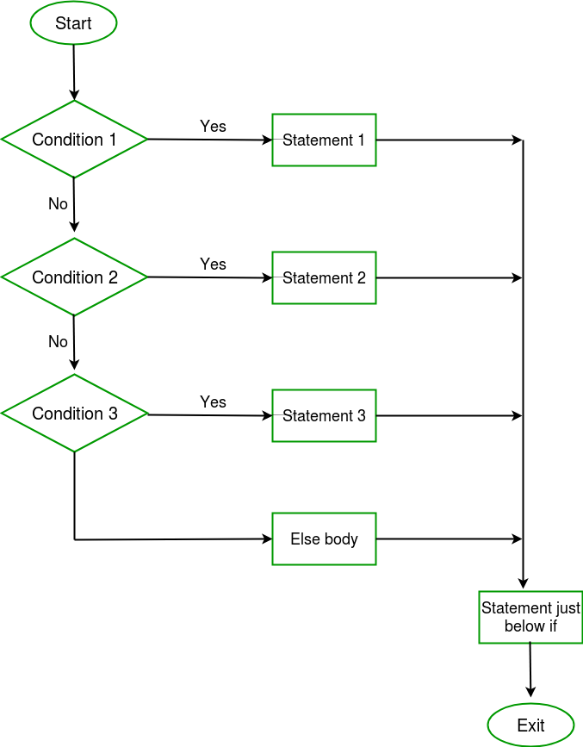
Decision-Making : simple if – else – if
Control Flow Statements
if-else-if: It is also called else-if ladder. Here execute any one block of statements among many blocks.
Syntax
if ( condition 1){
statement 1;
}else if ( condition 2 ){
statement 2;
}else if (condition 3){
statement 3;
} else {
else Body
}

Slide 17
Decision-Making : simple if – else – if
Control Flow Statements
/** * The IfEsleIFControlStructure class implements an application that * Illustrate the if ..elseif decision Making control statement */ class IfElseIFControlStructure{ public static void main(String[] args){ int colorValue=2; if(colorValue==1) System.out.println(“Color Blue!”); else if(colorValue==2) System.out.println(“Color Red!”); else System.out.println(“Color Green!”); } }
Output:
Color Red!

Slide 18
Decision-Making : simple if – else – if
Control Flow Statements
/** * The IfElseIf class implements an application that display the cost of the specific seat category in movie ticket booking using if ..elseif decision Making control statement for fixing the cost based on Movie Type */ import java.util.Scanner; public class IfElseIf { public static void main(String[] args){ String seattype; System.out.println(“Type of seats Available\nREGULAR\nPREMIUM\nEXECUTIVE\nVIP\ choose any one of the option : "); Scanner input = new Scanner(System.in); //Scanner class object creation seattype = input.next(); // get Seat Number from User if (seattype.equals("REGULAR")) { //Display detail for REGULAR type System.out.println("You have selected Executive Seat and cost is Rs.80"); }

Slide 19
Decision-Making : simple if – else – if
Control Flow Statements
else if (seattype.equals("PREMIUM")) { //Display detail for PREMIUM type System.out.println("You have selected Premium Seat and cost is Rs.100"); } else if (seattype.equals("EXECUTIVE")) { //Display detail for EXECUTIVE type System.out.println("You have selected Regular Seat and cost is Rs.120"); } else if (seattype.equals("VIP")) { //Display detail for VIP type System.out.println("You have selected VIP Seat and cost is Rs.150"); } else { System.out.println("You have not selected any type"); } input.close(); } }

Slide 20
Decision-Making : simple if – else – if
Control Flow Statements
Output:
Type of seats Available
REGULAR
PREMIUM
EXECUTIVE
VIP
choose any one of the option : PREMIUM
You have selected Premium Seat and cost Rs.100

Slide 21
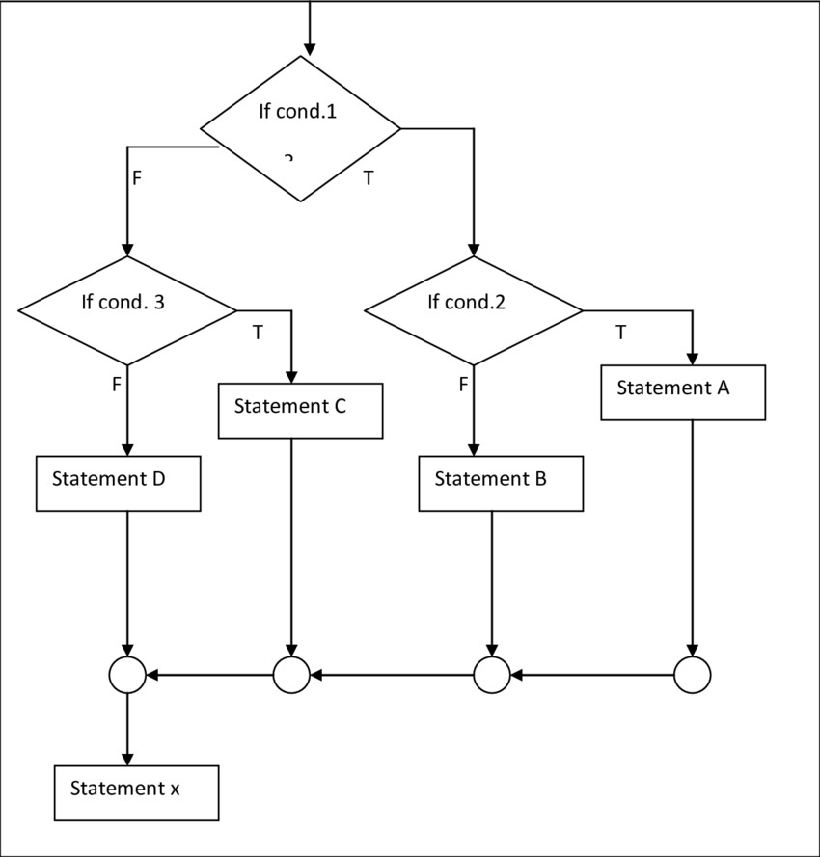
Decision-Making : Nested if
Control Flow Statements
Nested if: Use more than if statement inside another if statement. The outer if statement condition true means inside if statements execute.
Syntax
if ( condition 1){
if ( condition 2 ){
Nested if Body
}else{
Nested else Body
}
}else
else Body
}

Slide 22
Decision-Making : Nested if
Control Flow Statements
/* * The NestedIfControlStructure class implements an application that * Illustrate the nestedif decision Making control statement */ class NestedIFControlStructure{ public static void main(String[] args){ int age=15; int weight=50; if(age>18) { if(weight>50) System.out.println(“You are eligible to denote blood”); else System.out.println(“Not eligible because you are under weight”); } else System.out.println(“Not eligible because you are under age”); } }
Output:
Not eligible because you are underage

Slide 23
Decision-Making : Nested if
Control Flow Statements
/* * The Booking class implements an application that validates the login and check for the seat availability * using nestedif decision Making control statement */ import java.util.*; public class NestedIf { public static void main(String[] args){ String username = "Sarvesh",password = "sarvesh@123",usernameentered,passwordentered; boolean seatAvailable = true; String seatNumber; Scanner input = new Scanner(System.in); //Scanner class object creation System.out.println("Enter the Username : "); username = input.next(); //getting the username System.out.println("Enter the Password : "); password = input.next(); //getting the username

Slide 24
Decision-Making : Nested if
Control Flow Statements
if (usernameentered.equals(username) && password.equals(password)) { //validate the user login System.out.println("You have logged in and you can book a ticket now"); System.out.println("Enter the Seat Number : "); seatNumber = input.next(); // get the seat number from the user if (seatAvailable) { // check for seat availability status System.out.println("Seat Number "+seatNumber+" you have chosen is available"); } else{ System.out.println("Your expected Seat Number "+seatNumber+" is not available"); } } else{ System.out.println("You have to login for booking the ticket"); } input.close(); } }

Slide 25
Decision-Making : Nested if
Control Flow Statements
Output:
Enter the Username : Sarvesh
Enter the Password : sarvesh@123
You have logged in and you can book a ticket now
Enter the Seat Number : A10
Seat Number A10 you have chosen is available

Slide 26
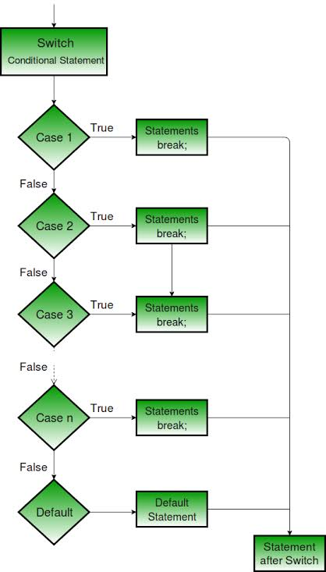
Decision-Making : switch - case
Control Flow Statements
switch-case: Select one of many possible statements to execute. It gives alternate for long if..else..if ladders which improves code readable.
Syntax
switch ( expression ) {
case value1 :
statement-list1;
break;
case value2 :
statement-list 2;
break;
default:
statement-list 3;
break;
}

Slide 27
Decision-Making : switch - case
Control Flow Statements
Note:
In switch, Case value must be in expression type only and case values must be unique.
Expression must be of byte, short, int, long, enums and string.
Each case break statement is optional. It helps terminate from switch expression. If a break statement is not found, it executes the next case.
The case value can have a default label which is optional.

Slide 28
Decision-Making : switch - case
Control Flow Statements
/** The SwitchControlStructure class implements an application that * Illustrate switch decision Making control statement */ class SwitchControlStructure{ public static void main(String[] args){ int letter='A'; switch(letter){ case 'a': System.out.println("Lowercase Letter"); break; case 'A': System.out.println("Uppercase Letter"); break;

Slide 29
Decision-Making : switch - case
Control Flow Statements
default: System.out.println("Invalid Letter"); break; } }
Output:
Uppercase Letter

Slide 30
Decision-Making : switch - case
Control Flow Statements
/** The SwitchCase class implements an application that demonstrate the movie searching by different types of languages * using switch decision Making control statement Searching the Movie detail by Title, Language, ReleaseDate, Genre*/ import java.util.Scanner; public class SwitchCase { public static void main(String[] args){ System.out.println("Enter the type to be search \n1. Search by Title \n2. Search by Language \n3. Search by Release Date \n4. Search by Genre \nEnter the Choice (1/2/3/4)"); Scanner input = new Scanner(System.in); //Scanner class object creation int choice = input.nextInt(); //getting the choice from user switch(choice){ case 1: System.out.println("Your searching choice is Movies by Title"); break; case 2:

Slide 31
Decision-Making : switch - case
Control Flow Statements
System.out.println("Your searching choice is Movies by Language"); break; case 3: System.out.println("Your searching choice Movies by Release Date"); break; case 4: System.out.println("Your searching choice Movies by Genre"); break; default: System.out.print("Your choice is wrong. Please enter the correct choice "); } input.close(); } }

Slide 32
Decision-Making : switch - case
Control Flow Statements
Output:
Enter the type to be search
1. Search by Title
2. Search by Language
3. Search by Release Date
4. Search by Genre
2
Your searching choice is Movies by Languagec

Slide 33
Looping - Introduction
Control Flow Statements
Loop/ iterative statements are used for executing a block of statements repeatedly until a particular condition is satisfied.
In Java, we have following loop statements:
while
do…while
for
for…each
Nested loops (for, while, do…while)

Slide 34
Looping - Introduction
Control Flow Statements
Four Looping Elements
Initialization: To set initial value to the iteration variable at the very start of the loop.
Condition: Test condition is evaluate and give boolean ( 0 or 1) value as a result.
Loop-body: If the test condition is true, the body of the loop runs once.
Updation: Increment/decrement statement executes just after executing the body, and then the program goes back to the test condition.

Slide 35
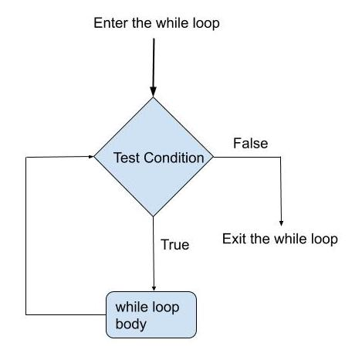
Looping - while
Control Flow Statements
while: It is used to rrepeat a specific block of code. It is preferable while we do not know the exact number of iterations of loop beforehand.
Syntax
while (condition){
statement(s)
}

Slide 36
Looping - while
Control Flow Statements
/** * The WhileStructure class implements an application that * Illustrate While Looping control statement */ class WhileStructure{ public static void main(String[] args){ int counter = 1; while (counter < 11) { System.out.println("Count is: " + counter); counter++; } } }

Slide 37
Looping - while
Control Flow Statements
Output:
Count is: 1
Count is: 2
Count is: 3
Count is: 4
Count is: 5
Count is: 6
Count is: 7
Count is: 8
Count is: 9
Count is: 10

Slide 38
Looping - while
Control Flow Statements
/** * The ShowSeat class implements an application that display the current seat availability * using While Looping control statement */ public class ShowSeat { public static void main (String args[]){ int MaxSeatCount = 10, seatCount = 0; while(seatCount < MaxSeatCount){ System.out.println(“Current Seat Availability : "+(MaxSeatCount-seatCount)); seatCount++; } System.out.println("Seats are Filled"); } }

Slide 39
Looping - while
Control Flow Statements
Output:
Current Seat Availability : 10
Current Seat Availability : 9
Current Seat Availability : 8
Current Seat Availability : 7
Current Seat Availability : 6
Current Seat Availability : 5
Current Seat Availability : 4
Current Seat Availability : 3
Current Seat Availability : 2
Current Seat Availability : 1
Seats are Filled

Slide 40
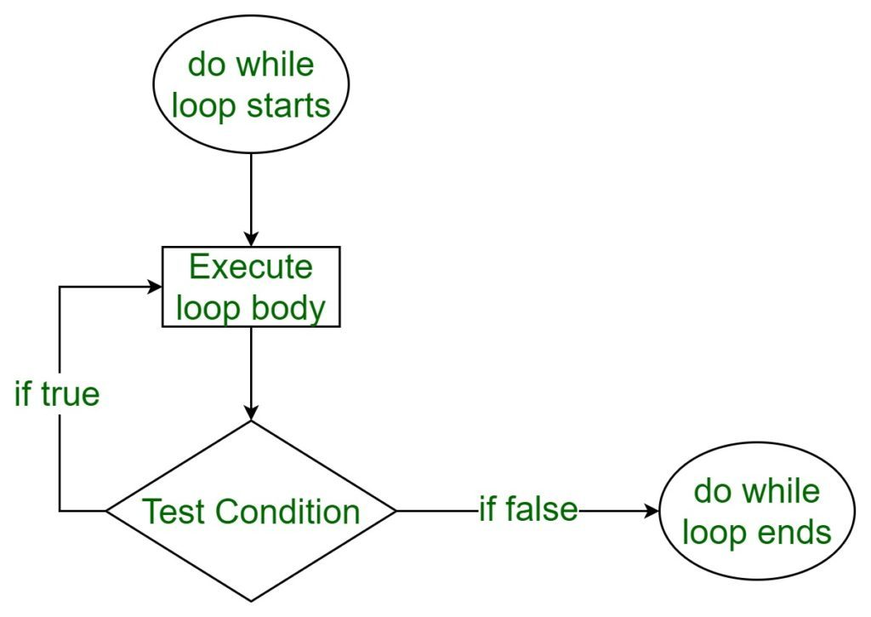
Looping - do - while
Control Flow Statements
do-while: Executes the statement first and then checks for the condition. It is also called an exit-controlled loop.
Syntax
do {
statement(s)
} while (condition);

Slide 41
Looping - do - while
Control Flow Statements
/** * The DoWhileStructure class implements an application that that checks the seat availability * status for movie ticket booking and Illustrate do..while Looping control statement */ class DoWhileStructure{ public static void main(String[] args){ int counter = 1; do { System.out.println("Count is: " + counter); counter++; } while (counter < 11) } }

Slide 42
Looping - do - while
Control Flow Statements
Output:
Count is: 1
Count is: 2
Count is: 3
Count is: 4
Count is: 5
Count is: 6
Count is: 7
Count is: 8
Count is: 9
Count is: 10

Slide 43
Looping - do - while
Control Flow Statements
/** * The ShowSeat class implements an application that that checks the seat * availability status for movie ticket booking using do.. while Looping control statement */ public class ShowSeat { public static void main (String args[]){ int MaxSeatCount = 5, seatCount = 0; do{ System.out.println("Current Seat Availability : "+(MaxSeatCount-seatCount)); seatCount++; } while(seatCount < MaxSeatCount); System.out.println("Seats are Filled"); } }

Slide 44
Looping - do - while
Control Flow Statements
Output:
Current Seat Availability : 5
Current Seat Availability : 4
Current Seat Availability : 3
Current Seat Availability : 2
Current Seat Availability : 1
Seats are Filled

Slide 45
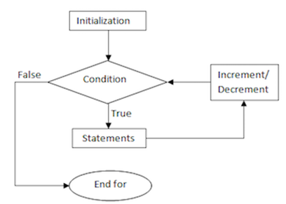
Looping - for
Control Flow Statements
for: When you know exactly how many times you want to loop through a block of code, use the for loop instead of a while loop
Syntax
for (initialization; condition ; updation) {
statement(s)
}
Initialization : Initializes the loop; it's executed once.
Condition : Evaluates till the condition becomes false.
Updation : Increment / Decrement the value. Executed (every time) after the code block is executed.

Slide 46
Looping - for
Control Flow Statements
/** * The ForStructure class implements an application that * Illustrate ForLooping control statement */ class ForStructure{ public static void main(String[] args) { for(int count = 1; count<10; count++) { System.out.println("Count is: " + count); } }

Slide 47
Looping - for
Control Flow Statements
Output:
Count is: 1
Count is: 2
Count is: 3
Count is: 4
Count is: 5
Count is: 6
Count is: 7
Count is: 8
Count is: 9

Slide 48
Looping - for
Control Flow Statements
/** * The ShowSeat class implements an application that that checks the seat availability status for * movie ticket booking using For Looping control statement */ class ShowSeat{ public static void main (String args[]){ int MaxSeatCount = 5, seatCount = 0; for(seatCount=0;seatCount < MaxSeatCount;seatCount++){ System.out.println("Current Seat Availability : "+(MaxSeatCount-seatCount)); } System.out.println("Seats are Filled"); } }

Slide 49
Looping - for
Control Flow Statements
Output:
Current Seat Availability : 5
Current Seat Availability : 4
Current Seat Availability : 3
Current Seat Availability : 2
Current Seat Availability : 1
Seats are Filled

Slide 50
Looping - for - each
Control Flow Statements
for-each: It’s commonly used to iterate over an array or a Collections class. It is also called enhanced for loop.
Syntax:
It is used to iterate over the elements of a collection without knowing the index of each element.
It is immutable which means the values which are retrieved during the execution of the loop are read only
for (type var : arrayName) {
statements;
}

Slide 51
Looping - for - each
Control Flow Statements
/** * The ForEachApp class implements an application that * illustrate foreach looping Structure */ class ForEachApp{ public static void main (String args[]){ int[] marks = { 125, 132, 95, 116, 110 }; int maxSoFar = marks[0]; //for each loop

Slide 52
Looping - for - each
Control Flow Statements
for (int indexValue : marks){ if (indexValue > maxSoFar){ maxSoFar = indexValue; } } System.out.println("The highest score is " +maxSoFar); } }
Output:
The highest score is 132

Slide 53
Looping - for - each
Control Flow Statements
/** * The ForEach class implements an application that list the movie based on their Genre * using foreach looping Structure */ import java.util.Scanner; public class ForEach { public static void main(String[] args) { String MovieName[] = {"AAA","BBB","CCC","DDD"}; String MovieGenre[] = {"ACTION","COMEDY","THRILLER","ACTION"}; Scanner input = new Scanner(System.in); //Scanner class object creation System.out.println("Enter the Genre to be searched : "); String Genre = input.next(); int counter = 0;

Slide 54
Looping - for - each
Control Flow Statements
System.out.println(Genre + " Movies are"); for (String M : MovieGenre ) { if(M.equals(Genre)) { System.out.println(MovieName[counter]); } counter++; } input.close(); } }
Output:
Enter the Genre to be searched :
ACTION
ACTION Movies are
AAA
DDD

Slide 55
Nested Loop
Control Flow Statements
Nested Loop: A loop inside another loop is called a nested loop. The number of loops depend on the requirement of a problem. It contains outer loop and inner loop. For each iteration of outer loop the inner loop executes completely.
Syntax
while(condition) {
statements(s)
while(condition) {
statement(s)
……..
}
………..
}
for (initialization; condition; updation) {
……..
for (initialization; condition; updation) {
statement(s)
…….
}
……….
}
do { ……….
statement(s)
do {
statement(s)
………
} while(condition);
……….
} while(condition);

Slide 56
Nested Loop
Control Flow Statements
/** * The NestedWhileApp class implements an application that * illustrate nested while loop */ class NestedWhileAPP{ public static void main (String args[]){ int outerLoop=1,innerLoop=1; whlie(outerLoop<=5){ while(innerLoop<=5){ System.out.print(“*”); innerLoop++; }

Slide 57
Nested Loop
Control Flow Statements
System.out.println(“ “); outerLoop++; innerLoop=1; } } }
Output:
*****
*****
*****
*****
*****

Slide 58
Nested Loop
Control Flow Statements
/** * The NestedWhile class implements an application that demonstrate the seat availability while the seats are getting booked in multiple screens using nested while loop */ class NestedWhile{ public static void main (String args[]){ int MaxSeatCount = 5, TotalScreenCount = 2, seatCount = 0, screenCount = 0; while(screenCount < TotalScreenCount){ seatCount = 0; System.out.println("Screen "+(screenCount+1)+" Availability details"); while(seatCount < MaxSeatCount){ System.out.println("Current Seat Availability : "+(MaxSeatCount-seatCount)); seatCount++; }

Slide 59
Nested Loop
Control Flow Statements
System.out.println("Seats Filled in Screen "+(screenCount+1)); screenCount++; } } }
Output:
Screen 1 Availability details
Current Seat Availability : 5
Current Seat Availability : 4
Current Seat Availability : 3
Current Seat Availability : 2
Current Seat Availability : 1
Seats Filled in Screen 1
Screen 2 Availability details
Current Seat Availability : 5
Current Seat Availability : 4
Current Seat Availability : 3
Current Seat Availability : 2
Current Seat Availability : 1
Seats Filled in Screen 2

Slide 60
Nested Loop
Control Flow Statements
/** * The Nested DoWhileApp class implements an application that illustrate nested do…while loop */ class NestedDoWhileApp { public static void main (String args[]){ int outerLabel= 1; do { int innerLabel = 1; do{ System.out.print(outerLabel); innerLabel++; } while (innerLabel <= 3); outerLabel++; } while (outerLabel <= 3); } }
Output:
111222333

Slide 61
Nested Loop
Control Flow Statements
/** * The NestedDoWhile class implements an application that demonstrate the seat availability while the seats are getting booked in multiple screens using nested do…while loop */ class NestedDoWhile{ public static void main (String args[]){ int MaxSeatCount = 10, TotalScreenCount = 2, seatCount = 0, screenCount = 0; do{ System.out.println("Screen "+(screenCount+1)+" Availability details"); seatCount = 0; do{ System.out.println(“Current Seats Availability : "+(MaxSeatCount-seatCount)); seatCount++; } while(seatCount < MaxSeatCount);

Slide 62
Nested Loop
Control Flow Statements
System.out.println("Seats Filled in Screen "+(screenCount+1)); screenCount++; } while(screenCount < TotalScreenCount); } }
Output:
Screen 1 Availability details
Current Seat Availability : 5
Current Seat Availability : 4
Current Seat Availability : 3
Current Seat Availability : 2
Current Seat Availability : 1
Seats Filled in Screen 1
Screen 2 Availability details
Current Seat Availability : 5
Current Seat Availability : 4
Current Seat Availability : 3
Current Seat Availability : 2
Current Seat Availability : 1
Seats Filled in Screen 2

Slide 63
Nested Loop
Control Flow Statements
/** * The Nested ForApp class implements an application that * illustrate nested for looping structure */ class NestedForApp { public static void main (String args[]) { int rows = 5; // outer loop

Slide 64
Nested Loop
Control Flow Statements
for (int i = 1; i <= rows; ++i){ // inner loop to print the numbers for (int j = 1; j <= i; ++j) { System.out.print(j + " "); } System.out.println(""); } } }
Output:
1
1 2
1 2 3
1 2 3 4
1 2 3 4 5

Slide 65
Nested Loop
Control Flow Statements
/** * The NestedFor class implements an application that demonstrate the seat availability while the seats are getting booked in multiple screens and illustrate nested for looping structure */ class NestedFor{ public static void main (String args[]){ int MaxSeatCount = 5, TotalScreenCount = 2, seatCount = 0, screenCount = 0; System.out.println("Screen "+(screenCount+1)+" Availability details"); for(screenCount=0;screenCount < TotalScreenCount;screenCount++){ for(seatCount=0;seatCount < MaxSeatCount;seatCount++){ System.out.println("Current Seat Availability "+(MaxSeatCount-seatCount));

Slide 66
Nested Loop
Control Flow Statements
} System.out.println("Seats Filled in Screen "+(screenCount+1)); } } }
Output:
Screen 1 Availability details
Current Seat Availability : 5
Current Seat Availability : 4
Current Seat Availability : 3
Current Seat Availability : 2
Current Seat Availability : 1
Seats Filled in Screen 1
Screen 2 Availability details
Current Seat Availability : 5
Current Seat Availability : 4
Current Seat Availability : 3
Current Seat Availability : 2
Current Seat Availability : 1
Seats Filled in Screen 2

Slide 67
Branching - Unconditional
Control Flow Statements
Branching (Unconditional) - To transfers the control from one part of the program to another part without any condition.
In Java, we have the following unconditional statements:
break
labelled break
continue
labelled continue

Slide 68
Branching - Unconditional
Control Flow Statements
break: When a break statement is encountered inside a loop, the loop is immediately terminated and the program control resumes at the next statement following the loop.
The Java break is used to break loop or switch statement. It breaks the current flow of the program at specified condition. In case of inner loop, it breaks only inner loop.
Break statement use all types of loops such as for loop, while loop and do-while loop.
Syntax
break;

Slide 69
Branching - Unconditional
Control Flow Statements
/** * The BreakApp class implements an application that * illustrate Break branching statement */ class BreakApp{ public static void main (String args[]){ for(int count = 1;count<10;count++) { if(count ==5) break; //exit from the current loop System.out.println("Count is: " + count); } }
Output:
Count is: 1
Count is: 2
Count is: 3
Count is: 4

Slide 70
Branching - Unconditional
Control Flow Statements
/** * The UnconditionalBreak class implements an application that demonstrate the seat availability while the seats are getting booked assuming that the VIP seats are already reserved using Break branching statement */ class UnconditionalBreak { public static void main (String args[]){ int premiumSeat = 5, vipSeat = 5, seatBooked = 0; int totalSeat = premiumSeat + vipSeat; for(seatBooked = 0;seatBooked < totalSeat;seatBooked++) { if(seatBooked > premiumSeat) {

Slide 71
Branching - Unconditional
Control Flow Statements
System.out.println("All PREMIUM Seats Booked "); System.out.println("All VIP Seats 1 to 5 are Reserved "); break; //exit from the current loop } else { System.out.println(“PREMIUM Seat Availability : "+(premiumSeat - seatBooked)); } } } }

Slide 72
Branching - Unconditional
Control Flow Statements
Output:
PREMIUM Seat Availability : 5
PREMIUM Seat Availability : 4
PREMIUM Seat Availability : 3
PREMIUM Seat Availability : 2
PREMIUM Seat Availability : 1
All PREMIUM Seats Booked
All VIP Seats 6 to 10 are Reserved

Slide 73
Branching - Unconditional
Control Flow Statements
continue: When you need to jump to the next iteration of the loop immediately.
It continues the current flow of the program and skips the remaining code at the specified condition. In case of an inner loop, it continues the inner loop only.
Continue statement use all types of loops such as for loop, while loop and do-while loop.
Syntax:
continue;

Slide 74
Branching - Unconditional
Control Flow Statements
/** * The ContinueApp class implements an application that * illustrate Continue branching statement */ class ContinueApp { public static void main (String args[]) { for(int count = 1;count<10;count++) { if(count ==5) continue; System.out.println("Count is: " + count); } }
Output:
Count is: 1
Count is: 2
Count is: 3
Count is: 4
Count is: 6
Count is: 7
Count is: 8
Count is: 9

Slide 75
Branching - Unconditional
Control Flow Statements
/** * The UnconditionalContinue class implements an application that demonstrate the seat availability while the seats are getting booked assuming that the VIP seats are already reserved using Continue branching statement */ class UnconditionalContinue { Public static void main (String args[]){ int executiveSeat = 5, premiumSeat = 5, vipSeat = 5, seatBooked = 0; int totalSeat = regularSeat + executiveSeat + premiumSeat + vipSeat; for(seatBooked = 0;seatBooked < totalSeat;seatBooked++) { if(seatBooked < (vipSeat)){ System.out.println("All VIP Seats 1 to 5 are Reserved "); continue; }

Slide 76
Branching - Unconditional
Control Flow Statements
if(seatBooked < vipSeat + premiumSeat) { System.out.println(“PREMIUM Seat No : "+(seatBooked+1)); } if(seatBooked < (vipSeat + premiumSeat + executiveSeat)) { System.out.println("EXECUTIVE Seat No : "+(seatBooked+1)); } } } }
Output:
All VIP Seats 1 to 5 are Reserved
All VIP Seats 1 to 5 are Reserved
All VIP Seats 1 to 5 are Reserved
All VIP Seats 1 to 5 are Reserved
All VIP Seats 1 to 5 are Reserved
PREMIUM Seat No : 6
PREMIUM Seat No : 7
PREMIUM Seat No : 8
PREMIUM Seat No : 9
PREMIUM Seat No : 10
Executive Seat No : 11
Executive Seat No : 12
Executive Seat No : 13
Executive Seat No : 14
Executive Seat No : 15

Slide 77
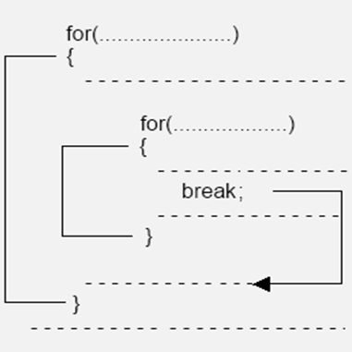
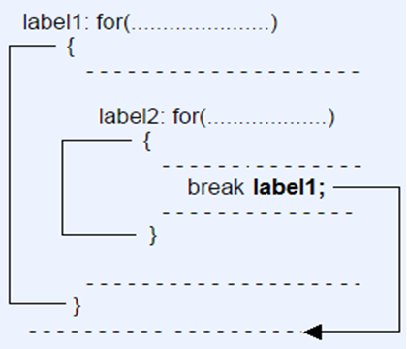
Branching - Unconditional
Control Flow Statements
Labeled Loop: In java, use labels with break and continue. A Label is used to identify a block of code. In case of multiple loop involved use labeled loop to transfer any specific loop with help of labels.
Loop without Label Loop with Label

Slide 78
Branching - Unconditional
Control Flow Statements
/** * The LabeledBreakApp class implements an application that * illustrate Labeled Break */ class LabeledBreakApp{ public static void main(String args[]){ first: // First label for (int i = 0; i < 3; i++) { second: // Second label for (int j = 0; j < 3; j++) { if (1== i && 1 == j) { // Using break statement with label break first; } System.out.println(i + " " + j); } } } }
Output:
0 0
0 1
0 2
1 0

Slide 79
Branching - Unconditional
Control Flow Statements
/** * The LabeledBreakApp class implements an application that illustrate Labeled Break */ public class LabelledBreak { public static void main (String args[]){ int MaxSeatCount = 10, TotalScreenCount = 2, seatCount = 0, screenCount = -1; Start: //System.out.println(screenCount); while(screenCount < TotalScreenCount){ screenCount++; System.out.println("Screen "+(screenCount+1)+" Seat Booked detail"); seatCount=0; while(seatCount < MaxSeatCount){ if(seatCount >3 && screenCount == 1) { System.out.println("Seat No 4 & 5 are Reserved");

Slide 80
Branching - Unconditional
Control Flow Statements
break Start; } else System.out.println("Seats No Booked : "+(seatCount+1)); seatCount++; } System.out.println("All Seats Filled in Screen "+(screenCount+1)); } } }

Slide 81
Branching - Unconditional
Control Flow Statements
Output:
Screen 1 Seat Booked detail
Seats No Booked : 1
Seats No Booked : 2
Seats No Booked : 3
Seats No Booked : 4
Seats No Booked : 5
All Seats Filled in Screen 1
Screen 2 Seat Booked detail
Seats No Booked : 1
Seats No Booked : 2
Seats No Booked : 3
Seat No 4 & 5 are Reserved

Slide 82
Branching - Unconditional
Control Flow Statements
/*** The LabeledContinueApp class implements an application that illustrate LabeledContinue loop */ class LabeledContinueApp { public static void main(String args[]){ first: // First label for (int i = 0 ; i < 3; i++) { second: // Second label for (int j = 0; j < 3; j++) { if (1 == i && 1 == j) { // Using continue statement with label continue second; } System.out.println(i + " " + j); } } } }
Output:
0 0
0 1
0 2
1 0
2 0
2 1
2 2

Slide 83
Branching - Unconditional
Control Flow Statements
/*** The LabeledContinueApp class implements an application that illustrate LabelledContinue loop */ public class LabelledContinue { public static void main (String args[]){ int MaxSeatCount = 5, TotalScreenCount = 2, seatCount = 0, screenCount = 0; SkipScreen: //System.out.println(screenCount); while(screenCount < TotalScreenCount){ System.out.println("Screen "+(screenCount)+" Ticket Booking detail"); seatCount=0; SkipSeat: while(seatCount < MaxSeatCount){ seatCount++;

Slide 84
Branching - Unconditional
Control Flow Statements
if((seatCount == 2 || seatCount == 3) && screenCount == 1) { System.out.println("Seat No "+seatCount+" is Reserved"); continue SkipSeat; } else System.out.println("Seats No Booked : "+(seatCount)); } System.out.println("All Seats Filled in Screen "+(screenCount+1)); screenCount++; } } }

Slide 85
Branching - Unconditional
Control Flow Statements
Output:
Screen 1 Ticket Booking detail
Seats No Booked : 1
Seats No Booked : 2
Seats No Booked : 3
Seats No Booked : 4
Seats No Booked : 5
All Seats Filled in Screen 1
Screen 2 Ticket Booking detail
Seats No Booked : 1
Seat No 2 is Reserved
Seat No 3 is Reserved
Seats No Booked : 4
Seats No Booked : 5
All Seats Filled in Screen 2

Slide 86

Quiz
Control Flow Statements
What do you call a statement that executes a certain statement(s) ,if the condition is true, and executes a different statement(s) if the condition is false?
a) if statement
b) if else statement
c) if else if statement
d) None of the Above
b) if else statement

Slide 87
Quiz
Control Flow Statements
2. From the given if-else statement, what will be displayed if the value of num is 6?
if (num>0) System.out.println(“Positive Number\n”); else System.out.println(“Negative Number\n”); System.out.println(“The number is %d”,num);
a) Positive Number
b) Negative Number
c) Positive Number
The number is 6
d) The number is 6
Positive Number
The number is 6

Slide 88
Quiz
Control Flow Statements
3. In switch case statement, what will be executed if there is no case matched?
a) case
b) break
c) default
d) All the above
c) default

Slide 89
Quiz
Control Flow Statements
4. What is a java keyword used in switch statements that causes immediate exit or that terminates the switch statement?
a) The case keyword
b) The switch keyword
c) The default keyword
d) The break keyword
d) The break keyword

Slide 90
Quiz
Control Flow Statements
5. Which of the following loops will execute the statements at least once, even though the condition is false initially?
a) while
b) do…while
c) for
d) All the options
b) do…while

Slide 91
Quiz
Control Flow Statements
6. What value is stored in index at the end of this loop?
for(int index =1;index<=10;index++)
a) 1
b) 9
c) 10
d) 11
b) 11

Slide 92
Quiz
Control Flow Statements
7. Which of the following are true about the enhanced for loop?
It can iterate over an array or a Collection but not a Map.
B. Using an enhanced for loop prevents the code from going into an infinite loop C. Using an enhanced for loop on an array may cause infinite loop. D. An enhanced for loop can iterate over a Map. E. You cannot find out the number of the current iteration while iterating.
a) A,B,E
b) A,B,C
c) B,C,E
d) A,D,E
a) A,B,E

Slide 93
Quiz
Control Flow Statements
8. What is printed as a result of the following code segment?
for (int k = 0; k < 20; k+=2)
{
if (k % 3 == 1)
System.out.print(k + " ");
}
a) 0 2 4 6 8 10 12 14 16 18
b) 4,6
c) 4,10,16
d) 0,6,12,18
c) 4,10,16

Slide 94
Quiz
Control Flow Statements
9. What is the output after the following code has been executed?
class FlowControl1 {
public static void main(String[] args){
int value1= 10, value2 = 20;
if (value1 < value2 ){
if (value2 > value2 )
System.out.println(“Hello Friend");
else
System.out.println(“ Happy Day!");
}
}
}

Slide 95
Quiz
Control Flow Statements
10. What is stored in the variable result after the following code has been executed?
class FlowControl2{
public static void main(String args[]){
int index = 0;
int result = 1;
while ( true ){
++index;
if ( index % 2 == 0 )
continue;
else if ( index % 5 == 0 )
break;
result *= 3;
}
}
}

Slide 96
Quiz
Control Flow Statements
11. What is the output after the following code has been executed?
class FlowControl3 {
public static void main(String[] args){
boolean b = true;
if(!b) {
System.out.println("HELLO");
} else {
System.out.println("BYE");
}
}
}

Slide 97
Quiz
Control Flow Statements
12. What is the output after the following code has been executed?
class FlowControl4 {
public static void main(String[] args){
for (int i = 0; ; i++) {
System.out.println("HIII");
}
System.out.println("BYE");
}
}

Slide 98
Quiz
Control Flow Statements
13. What is stored in the result after the following code has been executed?
class Test {
public static void main(String[] args){
do {
System.out.print(1);
do {
System.out.print(2);
} while (false);
} while (false);
}
}

Slide 99

Action is the foundational key to all success
- Pablo Picasso

